Slide 1
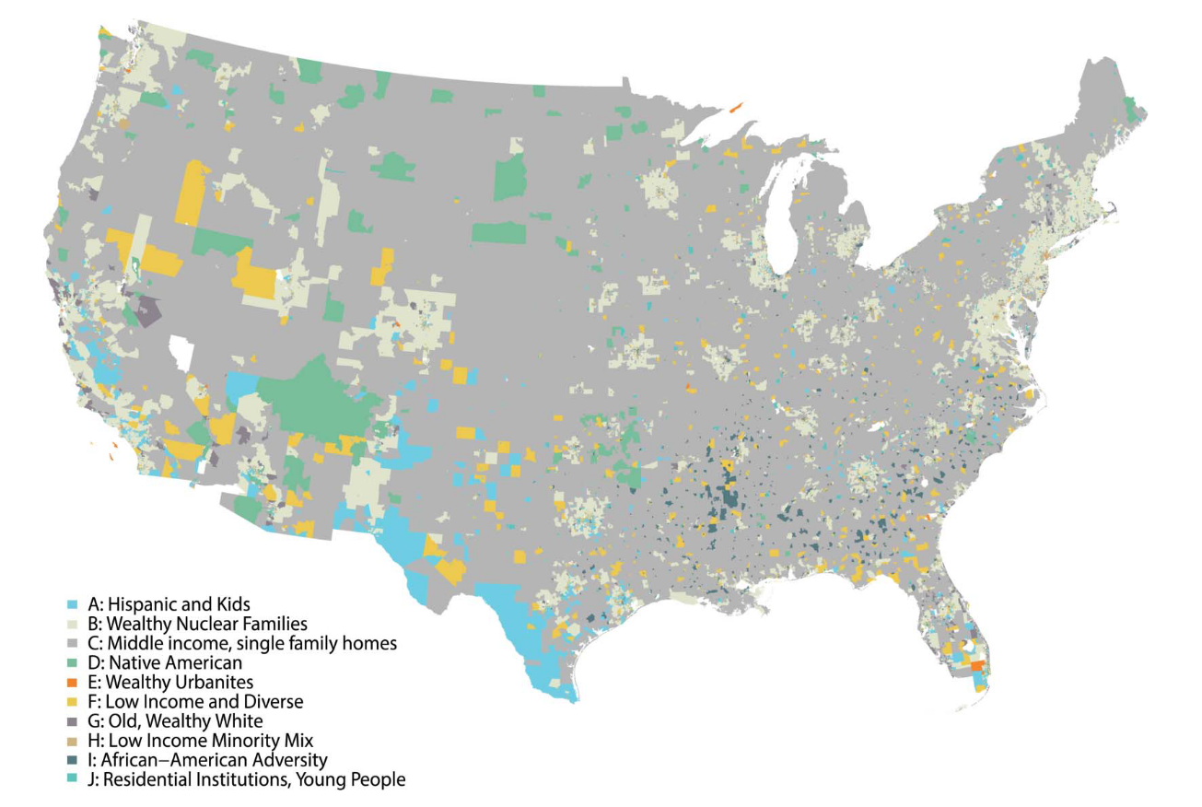




Retail and Geodemographics: A Spatial Data Science Approach
Patrick Ballantyne, University of Liverpool

Slide 2
Retail and Geodemographics: A Spatial Data Science Approach
Today’s workshop:
Concepts, ideas and research
Code, tools and insights

Slide 3
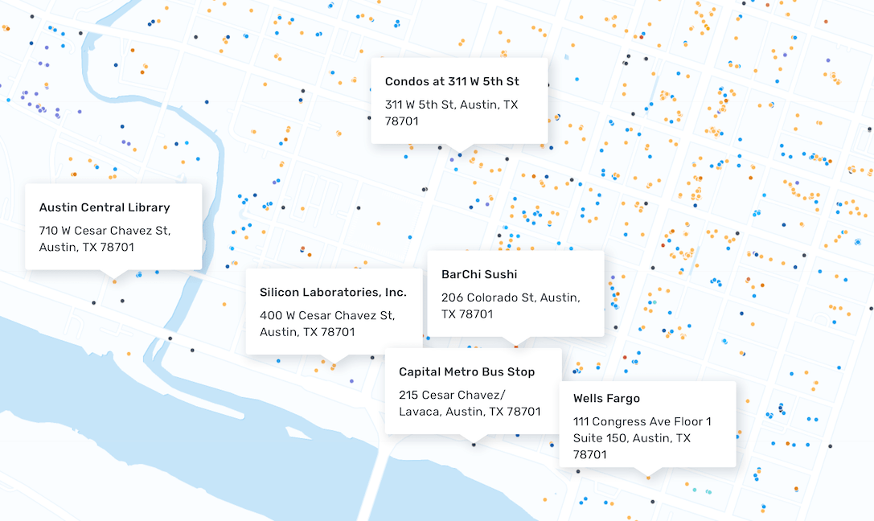



Retail and Retail : Approach
location_name | placekey | brands | top_category | sub_category
Bank of America | 222-222@8g7-3d4-tn5 | Bank of America | Depository Credit Intermediation | Commercial Banking
Bank of America | 222-222@8g6-ysq-k2k | Bank of America | Depository Credit Intermediation | Commercial Banking
Circle K | 222-222@8g7-4qd-975 | Circle K | Grocery Stores | Convenience Stores
Main Street Deli | Zzw-223@8g8-5bz-3wk | Independent | Grocery Stores | Convenience Stores

Slide 4
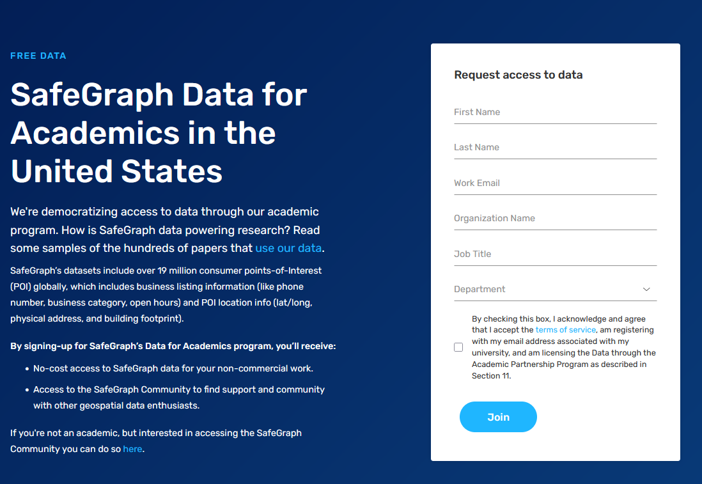
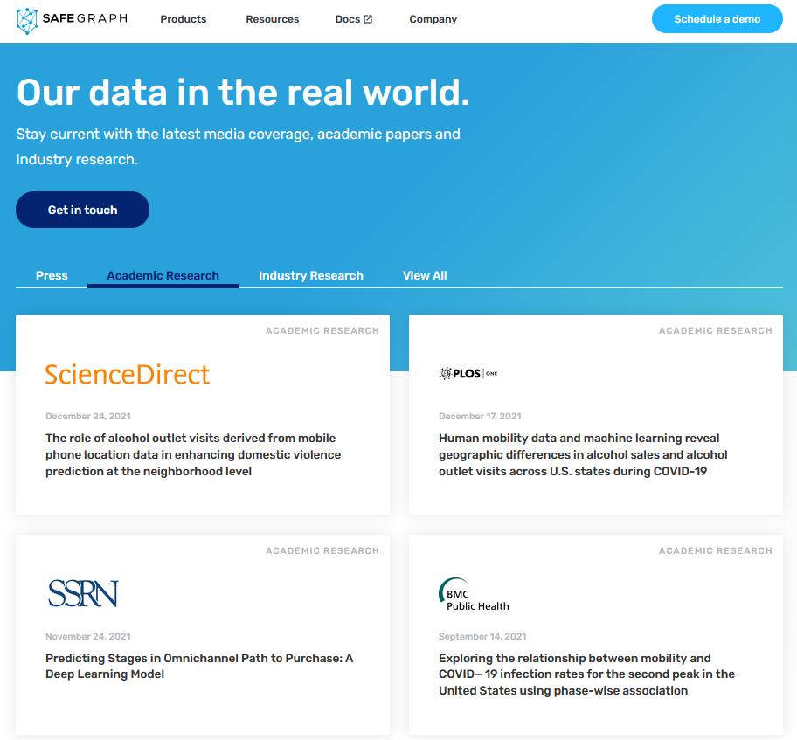
Retail and Retail : Approach

Slide 5
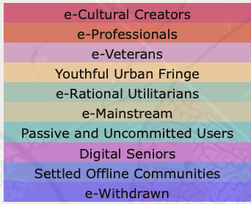
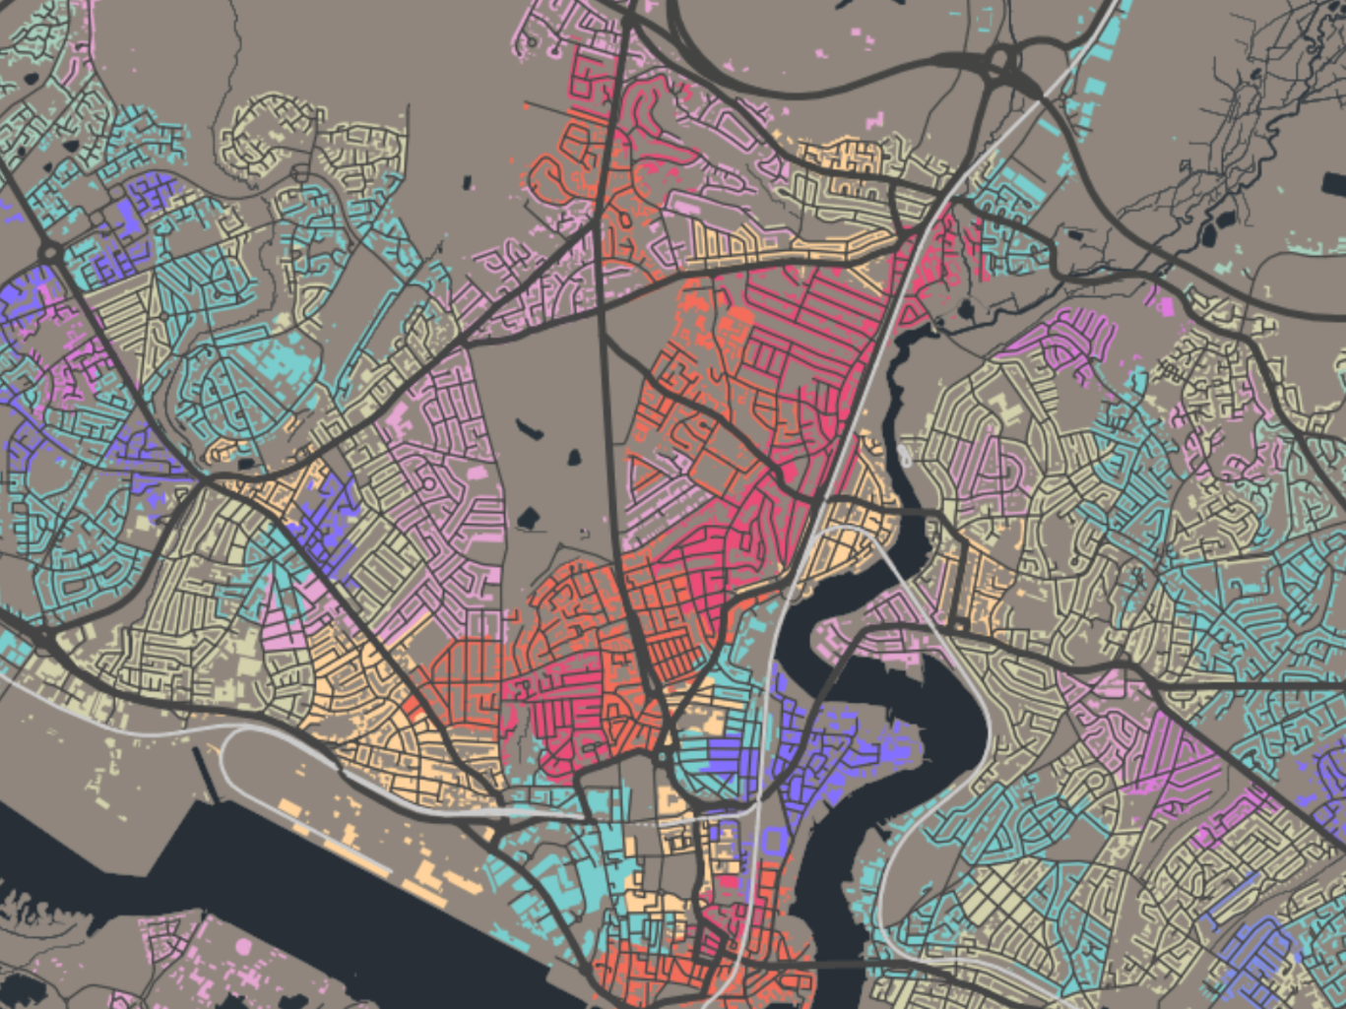
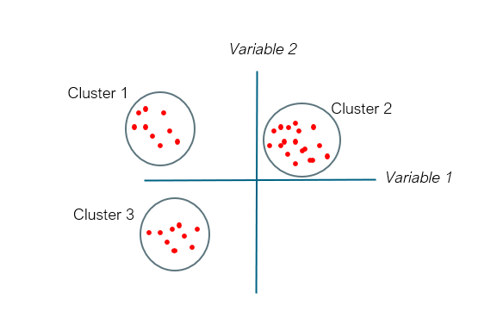
Retail and Geodemographics: A Spatial Data Science Approach
Area | Income | Age | Car | Employment | Degree | Commute
Area1
Area2
Area3
Area4

Slide 6
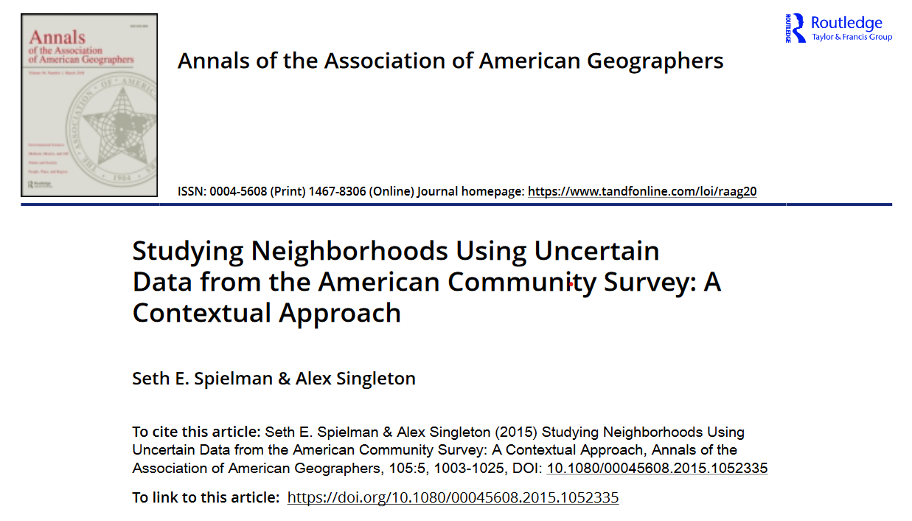
Overview:
Geodemographic classification of census tracts
American Community Survey (ACS)
How many variables? proach

Slide 7
Compare portraits of some groups…

Slide 8

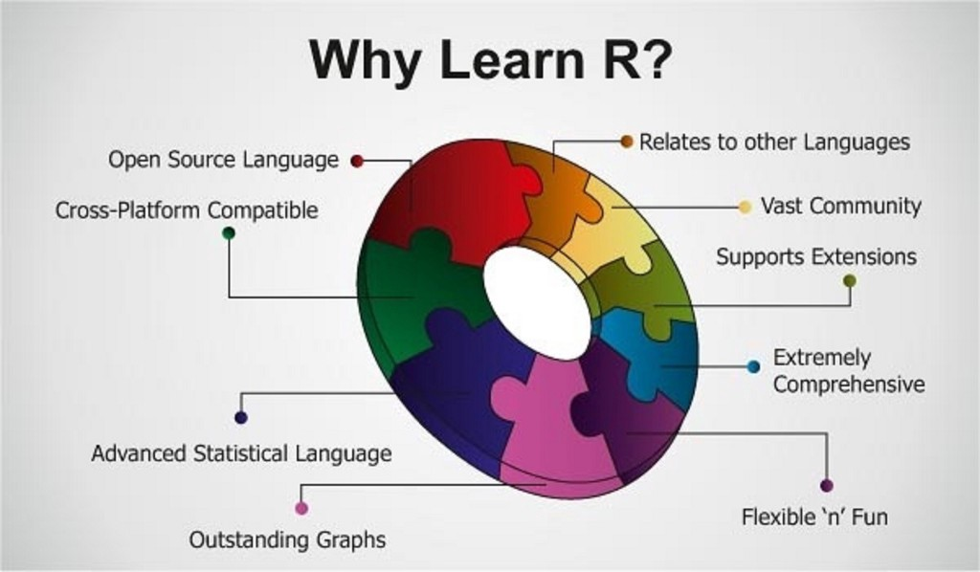

Retail and Today’s workshop : Approach
Language, syntax, commands...
IDE: friendlier, better functionality….
In a nutshell…

Slide 9
[ Demo 1 ]

Slide 10
[ Demo 2 ]

Slide 11
[ Demo 3 ]

